Slide 1

b
CVC-e
words

Slide 2

-eb
-ed
-eg
-en
-et
-ell

Slide 3
e
b
Word Family

Slide 4
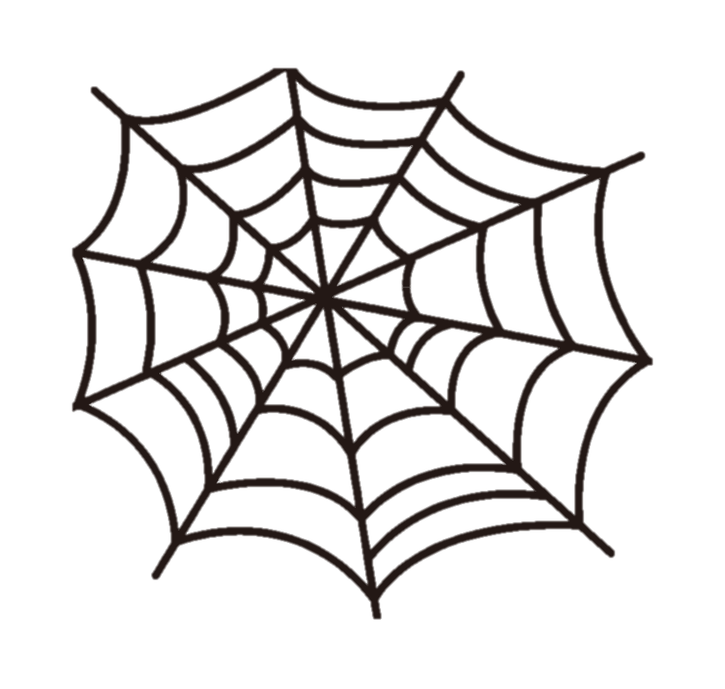
-eb
w-eb
web

Slide 5
e
d
Word Family

Slide 6
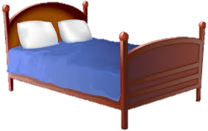


-ed
b-ed
bed
m-ed
med
r-ed
red

Slide 7
e
g
Word Family

Slide 8
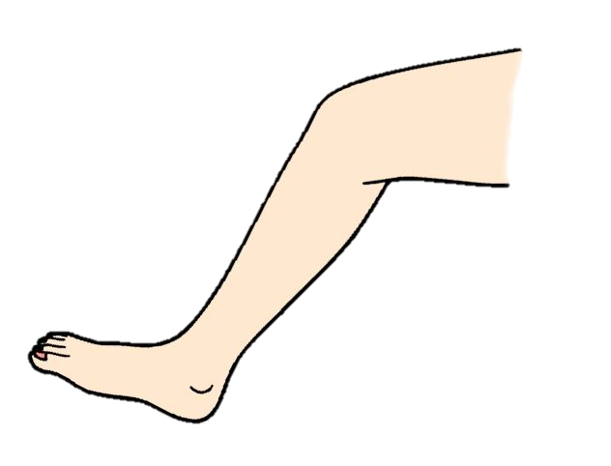
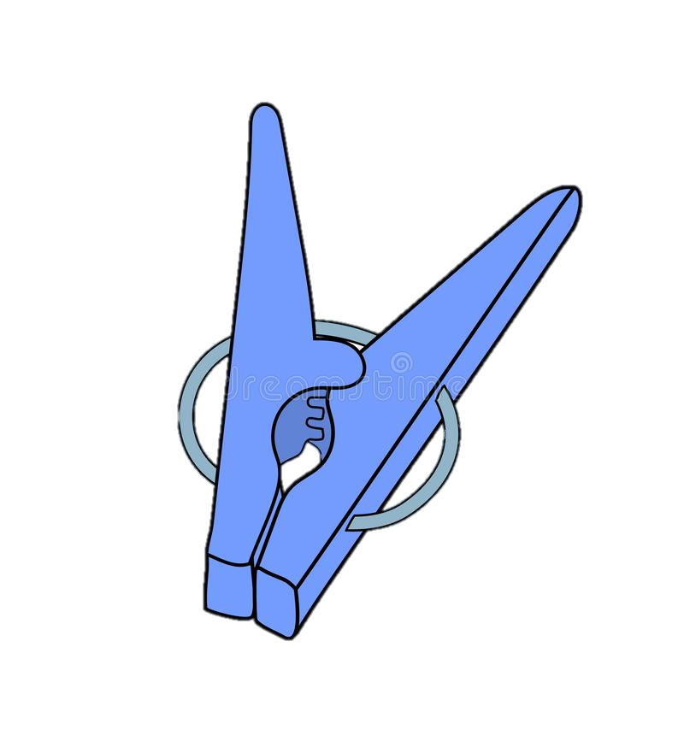
-eg
l-eg
leg
p-eg
peg

Slide 9
e
n
Word Family

Slide 10
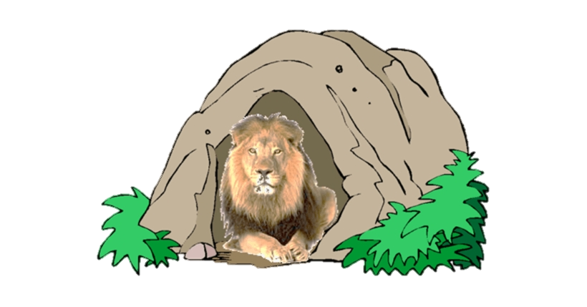
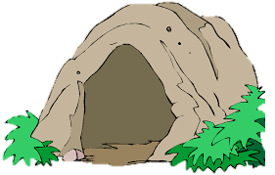


-en
d-en
den
h-en
hen
m-en
men

Slide 11


-en
p-en
pen
t-en
ten

Slide 12
e
t
Word Family

Slide 13



-et
g-et
get
j-et
jet
n-et
net

Slide 14



-et
p-et
pet
w-et
wet
v-et
vet

Slide 15
e
ll
Digraph
2 letters with one sound
Word Family

Slide 16


-ell
b-ell
bell
w-ell
well

Slide 17

Enrichment

Slide 18

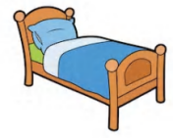


 | l | e | d
 | b | e | d
 | f | e | d
 | r | e | d

Slide 19



 | w | e | d
 | T | e | d
 | Z | e | d

Slide 20
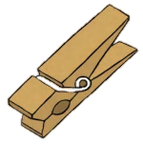
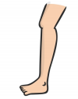


 | l | e | g
 | p | e | g
 | b | e | g
 | k | e | g

Slide 21
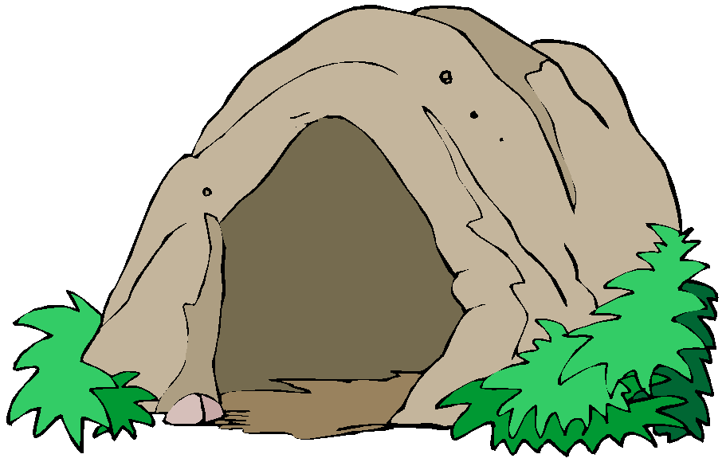


 | d | e | n
 | h | e | n
 | p | e | n

Slide 22


 | m | e | n
 | B | e | n
 | t | e | n

Slide 23
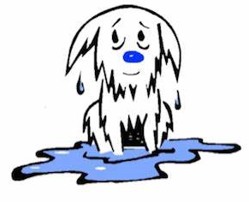
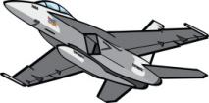
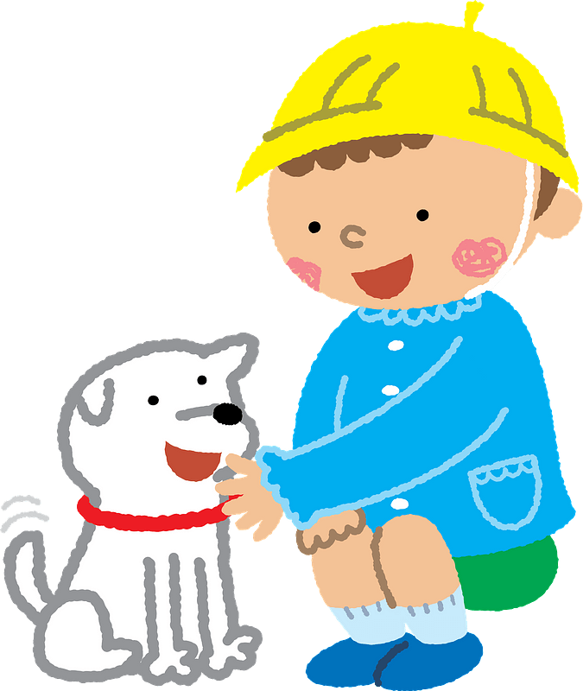
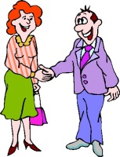
 | j | e | t
 | w | e | t
 | p | e | t
 | m | e | t

Slide 24



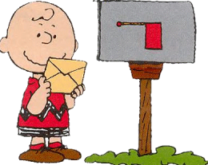
 | s | e | t
 | v | e | t
 | g | e | t
 | n | e | t

Slide 25




 | b | e | ll
 | d | e | ll
 | j | e | ll
 | f | e | ll

Slide 26
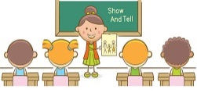
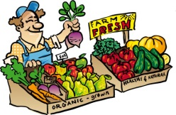
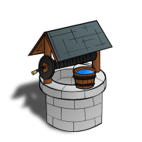
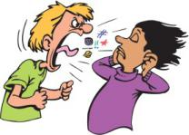
 | s | e | ll
 | t | e | ll
 | w | e | ll
 | y | e | ll

Slide 27



Slide 28
Run to the wall which shows the picture that corresponds to the word.
bell

Slide 29
Run to the wall which shows the picture that corresponds to the word.
hen

Slide 30
Run to the wall which shows the picture that corresponds to the word.
set

Slide 31

Run to the wall which shows the picture that corresponds to the word.
wed

Slide 32
Run to the wall which shows the picture that corresponds to the word.
leg

Slide 33


Slide 35

Spelling
g
b
e

Slide 36
Spelling
n
e
m

Slide 37
Spelling
j
e
t

Slide 38
Spelling
s
e
ll

Slide 39
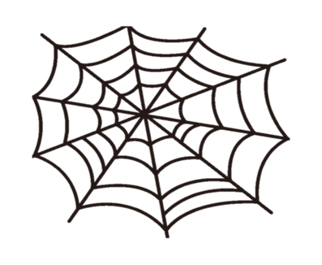
Spelling
b
e
w

Slide 40


Slide 41
